Slide 1
Updates from 2023
The SHARE Institute’s Annual Board Meeting
Notes:
ID=d924773e-9a16-4d6d-9803-8cb819e99682 Recipe=text_billboard Type=TextOnly Variant=0 FamilyID=AccentBoxWalbaum_Zero

Slide 2
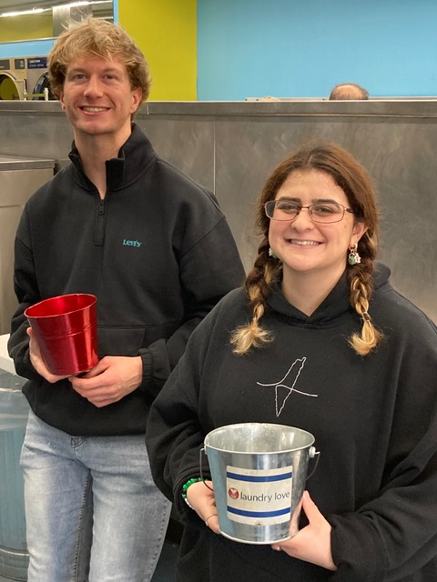
Interns & Winter Open House
Both of last year’s interns have received their scholarships and have transferred to their respective universities:
- Alex Kapnik – UC San Diego – Internat. Business
- Sara Altamimi – UC Berkeley – Poli. Sci. & Internat. Relations
We raised $1,155 at this year’s Open House.
- 50% from jewelry and card sales
- 50% from donations

Slide 3
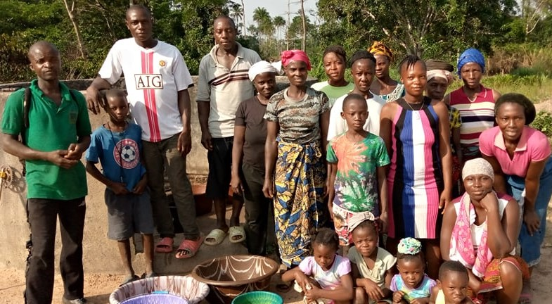
International Projects

Slide 4
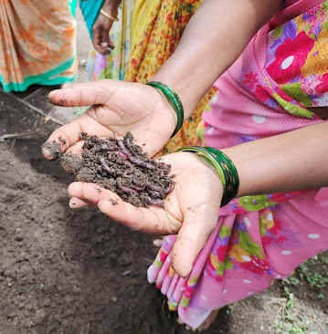
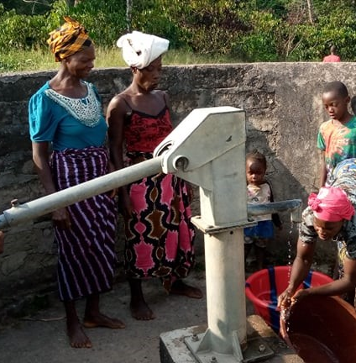
Long-Time Repeat Organizations
TAPWA, India
SWAA, DRC
CHEDRES, Nigeria
Shapes Lives International, Ghana
FOWACE, Liberia
Action for Change, Cameroon

Slide 5
Overview
Combined with the 4 Barbara projects and 3 adopted projects, there were 21 international projects totaling $10,500.
13/21 have worked with SHARE previously.
8/21 were brand new organizations.

Slide 6
Barbara Pillsbury & Edna Kroll Memorial Fund

Slide 7
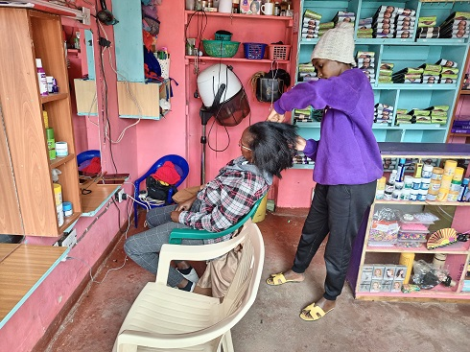
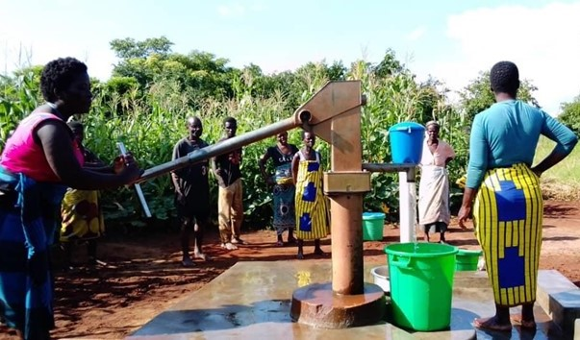
CHIREHO, Malawi:
Functional boreholes were established, providing clean water to 1200 individuals in 3 small communities.
Maintenance training for the boreholes was provided, and management committee members were trained in fund-raising and monitoring skills.
Kimbo Amazing Women, Kenya:
12 teen mothers were given hair stylist training and provided tools and equipment.
As part of the training, the girls worked for four hours a day for three months in a salon for a daily wage. At the end of the training period, the girls were hired on as permanent employees.

Slide 8
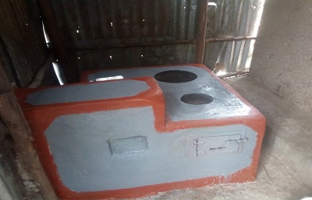
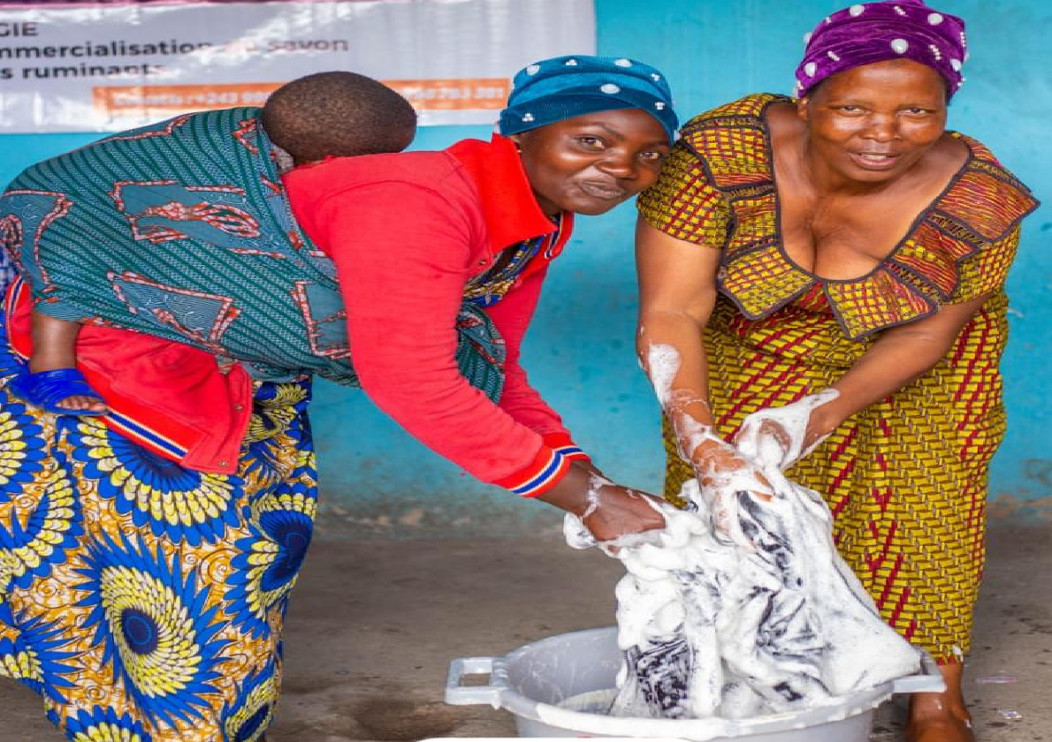
Kakere (KWG), Uganda:
40 impoverished rural women were trained to make and sell environmentally-friendly, suction-smoke-free stoves.
The project helped the beneficiaries increase their incomes and provides smoke-free houses to the families that purchase the stoves.
SWAA, Democratic Republic of Congo
30 internally-displaced women were trained to make and sell artisanal soap from palm oil.
This project benefitted the community on two fronts:
1. It provided income and job-training.
2. The soap from the project helped against hygienic diseases from the unsanitary living conditions in the refugee camps.
To make the project self-sustaining, the original 30 beneficiaries had to each train 5 additional women in what they learned.

Slide 9
Adopted Projects
Jennifer Bowl, Paula Christopher, & Geilan Toppozada

Slide 10
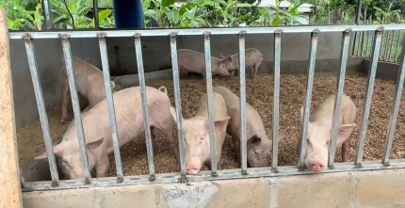
Shapes Lives International, Ghana – Jennifer Bowl:
20 women were trained in market-level pig-rearing techniques with the goal of increasing their incomes.
The women learned to select better breeds and identify qualities of feed and bedding for the pigs.
HWA, Uganda – Paula Christopher:
30 vulnerable young mothers were trained to make and market wedding cakes and street foods.
The beneficiaries tripled their incomes within a month of participating in the project.

Slide 11
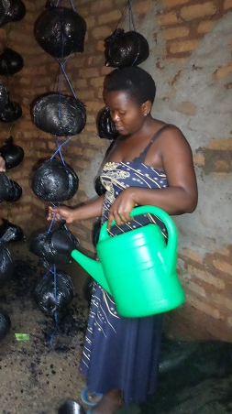
Geilan Toppozada – WACD, Uganda
30 women were trained to grow, cook, and market oyster mushrooms.
From the extra income, some beneficiaries were able to pay their children's school fees.
Others used the extra income to support their families.

Slide 12
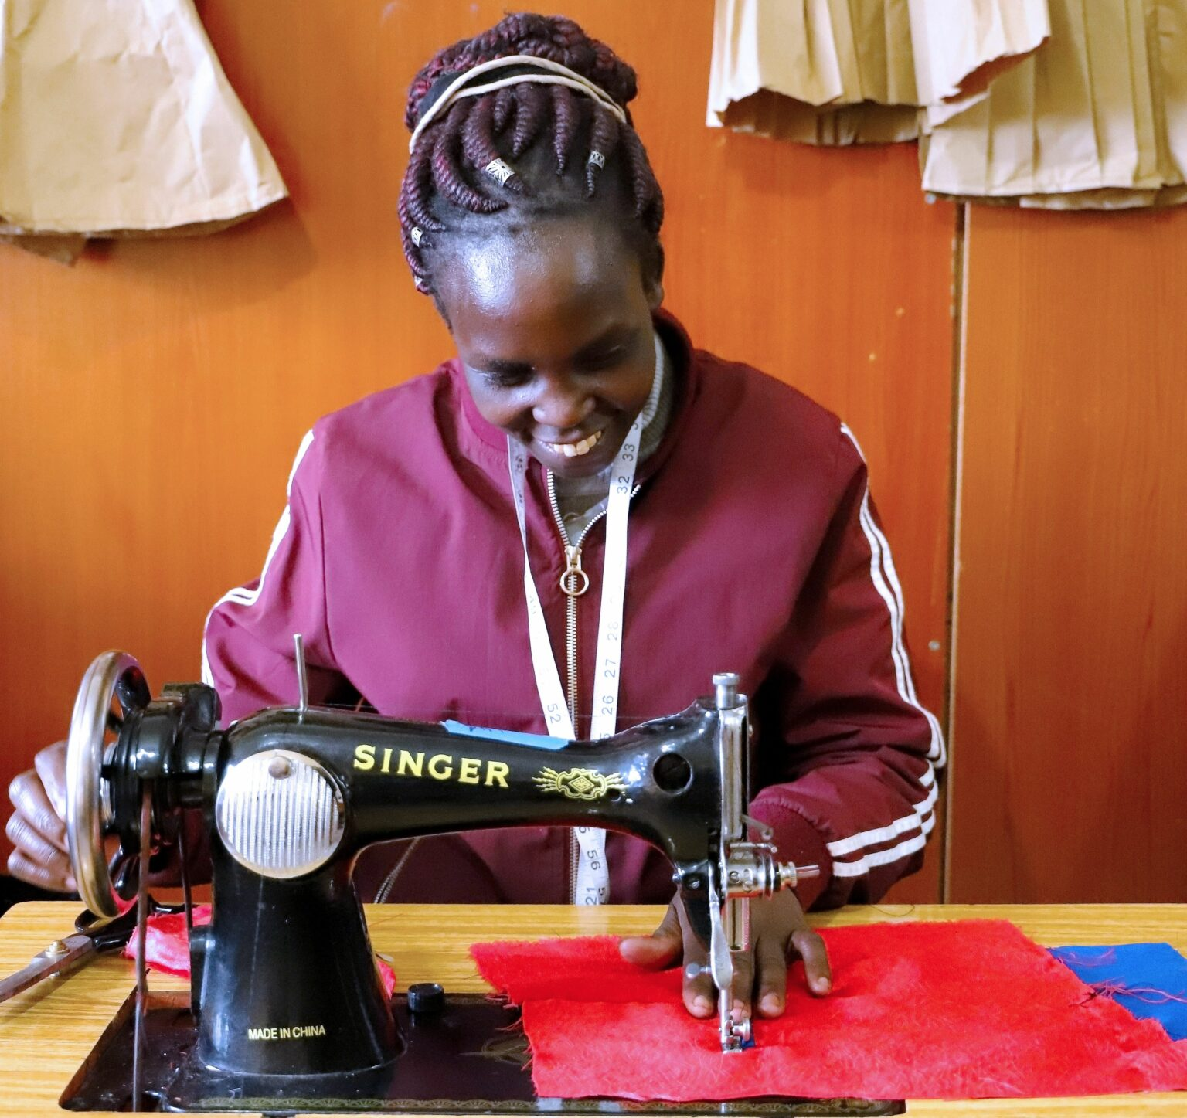
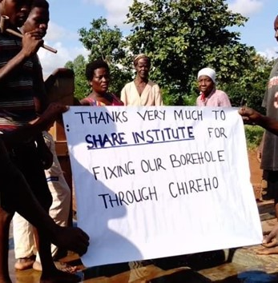
New Organizations
Ray Hope, Kenya
Ndekanga, Kenya
My Brother’s Keeper, Ghana
Uriama, Uganda
Kakere, Uganda
HWA, Uganda
WACD, Uganda
CHIREHO, Malawi

Slide 13
Ray Hope, Kenya
20 refugee women were trained in effective communication skills, marketing, and soap-making.
The case studies indicated a dramatic increase in income for the beneficiaries.

Slide 14
Ndekanga Support Self-Help Group, Kenya
10 women received small-business training and loans to create their own small businesses, which included:
- grocery sales
- tailoring
- selling clothing, cereals etc.
The women doubled their incomes and repaid 90% of the loans. This repayment allows the project to be self-sustaining, as loans can be given to a new batch of beneficiaries.

Slide 15
My Brother’s Keeper, Ghana
30 male and 62 female juvenile delinquents were mentored in handling life after imprisonment.
Volunteer Lawyer was procured to advocate for service and therapy for youth instead of jail time.
The goal of the project was to prevent rearrests by giving the beneficiaries marketable agricultural training.

Slide 16
Kanam Women’s Initiative, Kenya
20 teen mothers and reformed sex-workers were trained in climate-smart agriculture.
This included the use of sacks and garden pots to grow tomatoes and other crops.
The beneficiaries tripled their daily incomes by selling their produce at markets.

Slide 17
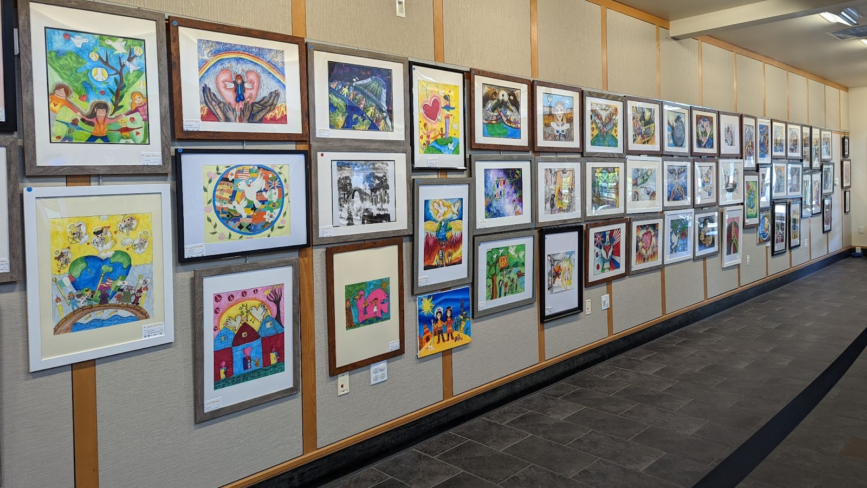
Domestic Projects

Slide 18
Overview
There were 10 domestic funded projects, totaling $2,709. 3 of these projects were with Laundry Love, our most successful domestic organization.
40% were based on a proposal written to SHARE.
60% were donations of charity bags or money. These donations provided meal vouchers and disaster relief in Maui and Mississippi.

Slide 19
Laundry Love: Our Most Successful Domestic Project
Due to a lack of viable domestic grants, we were able to work with Laundry Love on 3 separate projects:
- 1 microgrant of $500 to fund a laundry service day
- 1 microgrant to fund laundry services through their new laundry-billing app.
- 1 donation of giftbags created and donated by SHARE interns.
In addition to bringing the bags, our interns also volunteered for one Saturday to help Laundry Love with its operations.

Slide 20
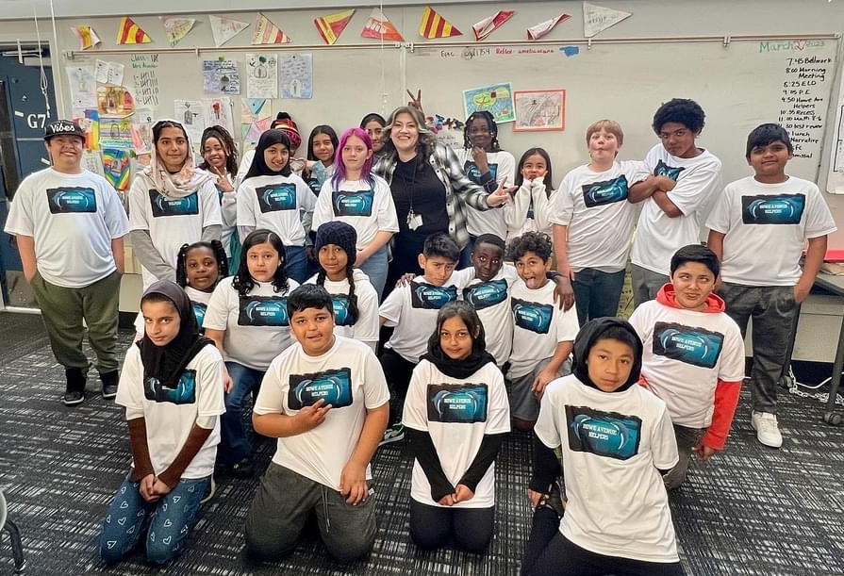
Howe Avenue Elementary: An Old Intern Comes Back
For the 2nd year in a row, a previous intern who now teaches at Howe Avenue Elementary has applied for SHARE funding.
This year, her students used the funds to create a civic responsibility club, “Howe Avenue Helpers”. As part of the club, students created and distributed 120 bags to the homeless in their community.
The grant helped students learn about civic duties and won them many awards.

Slide 21
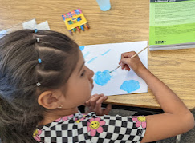
Omniware - Palo Alto, California
Established a summer enrichment program to serve 50 new immigrant children.
The program provided the children with basic art skills and opportunities to build confidence.

Slide 22
The Garden
We still give to food banks, primarily Sunrise Christian Food Ministry
Bad Crops: Tomatoes
Good Crops: Squash, zucchini, & cucumber

